Slide 1
7,000 Labeled Pokemon Images Classification
Bochen Dong
Zeduo Zhang

Slide 2
Outline
Dataset
First Attempt: baseline model
Reduce Overfitting
Dropout
Data Augmetaion
GAN
learning rate
Going to a deeper architecture
ResNet
Mobile Net
Final Model
challenges & future work

Slide 3
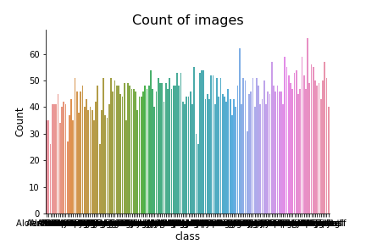
Dataset
7,000 Labeled and hand-cropped Pokemon images
150 classes (names of each pokemon)
each class contains 25 - 50 images
with the Pokemon in the center
have relatively high quality
perfect for light deep learing
resize to (192,192,3)
normalize to [0,1]
https://www.kaggle.com/lantian773030/pokemonclassification

Slide 4
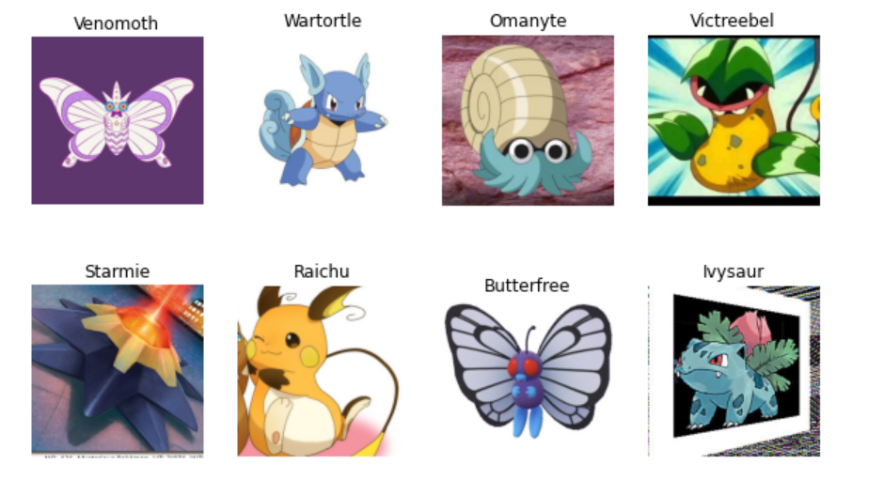

Slide 5
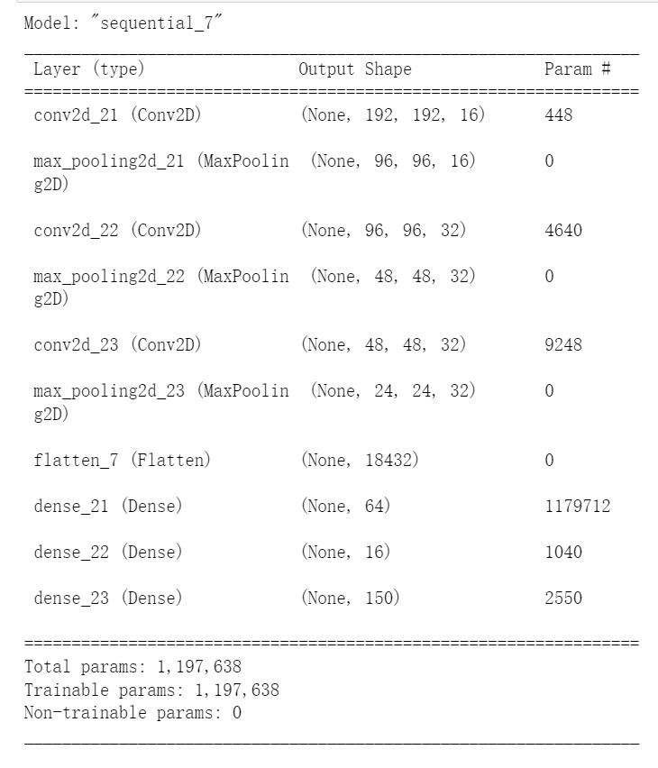
First Attempt: baseline model
3 loop (conv + max_pool)
3 fully connected layers

Slide 6
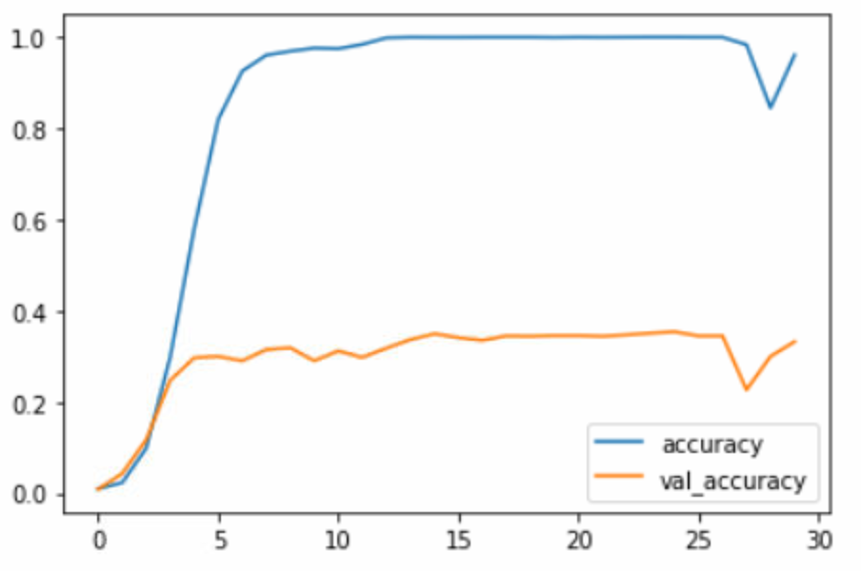
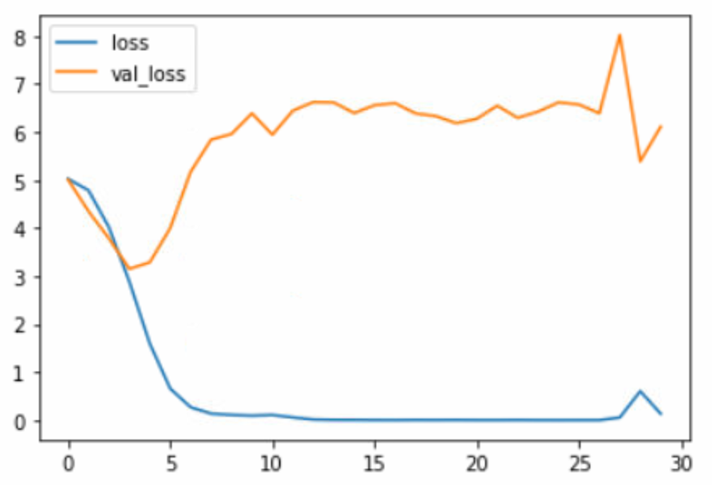
Baseline Model Result

Slide 7
Overfitting: Dropout
Dropout: improve generalization ability, address overfitting problem
add dropout layer after each maxpooling layer with different rates
add spatial dropout layer after each convolution layer with different rates
add dropout layer between visible layers with different rates
combination of techniques above

Slide 8
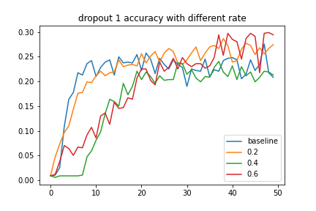
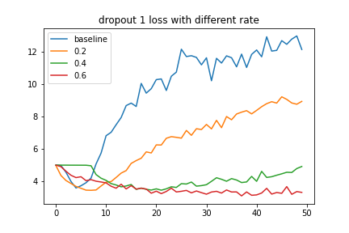
add dropout layer after each maxpooling layer with different rates

Slide 9
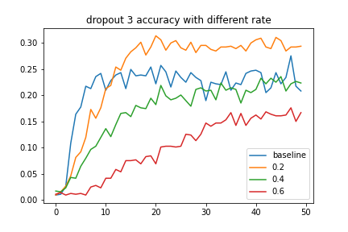
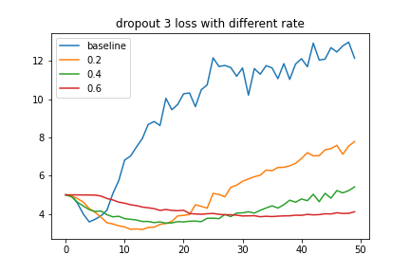
2. add spatial dropout layer after each convolution layer with different rates

Slide 10
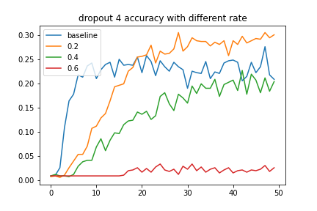
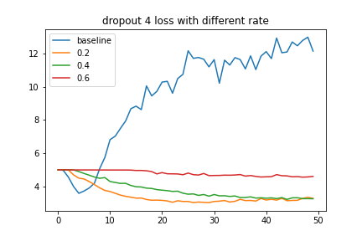
3. add dropout layer between visible layers with different rates

Slide 11
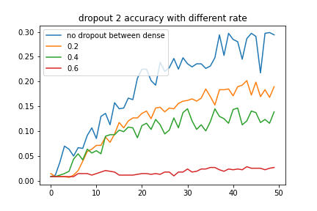
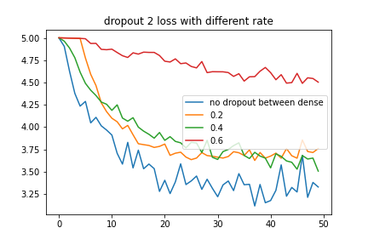
combination: add dropout layers with rate 0.6 after each maxpooling layer, and then add dropout layers between visible layers with rate (0.2, 0.4, 0.6)

Slide 12
Dropout: final decision
decide add dropout layer with rate 0.6 after each maxpooling layer
need to do more test, do it with our candidate model

Slide 13
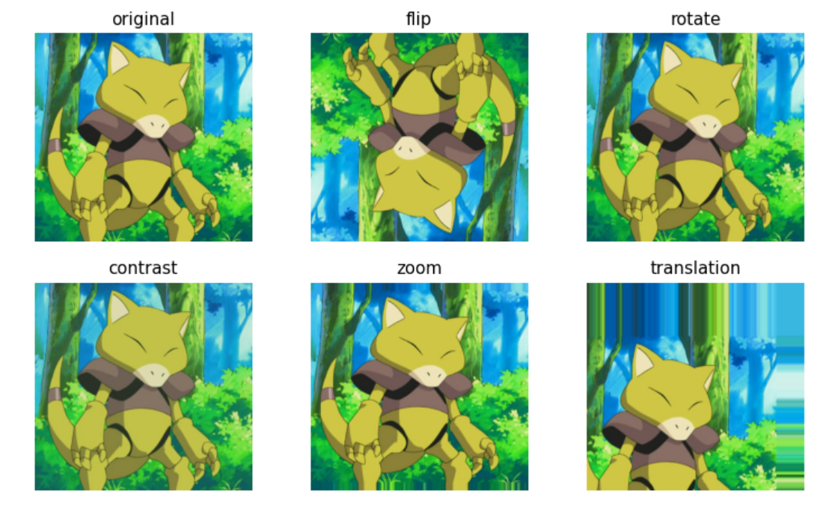
Overftting: Data Augmentation
increase complexity of the training dataset
improve model performance
techniques
flip
rotate
zoom
contrast
translation

Slide 14
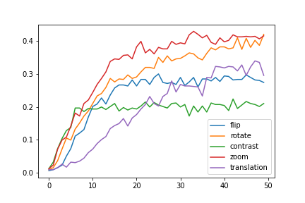
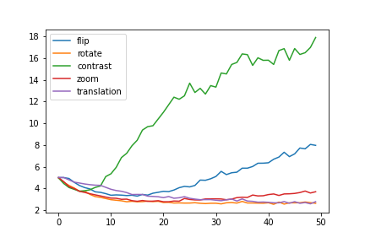
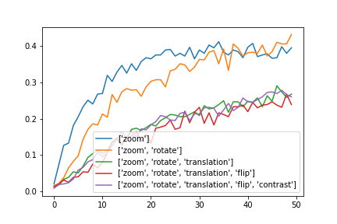
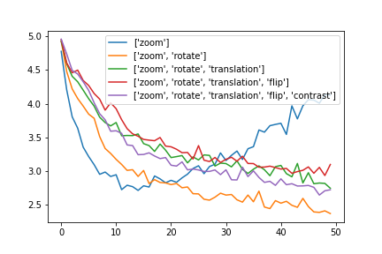
validation accuracy
validation loss

Slide 15
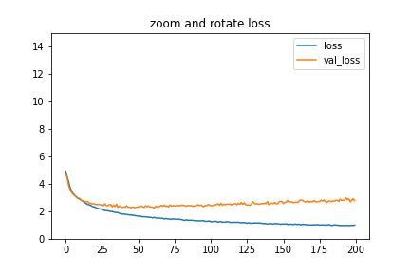
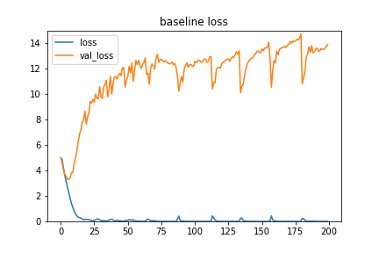
Data Augmentation: final decision
zoom and rotate

Slide 16
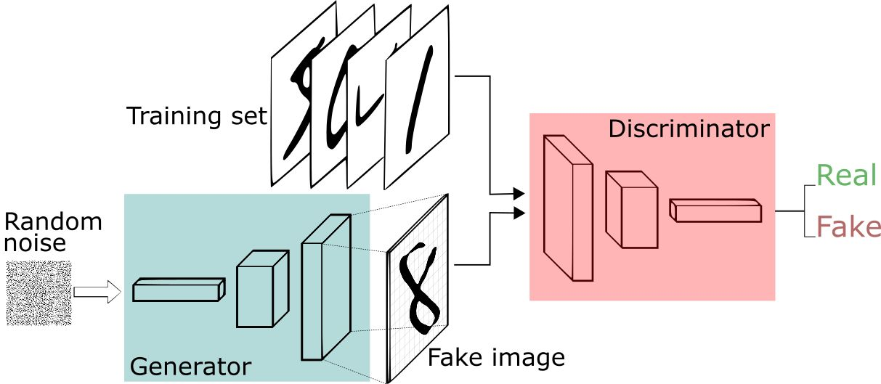
Overfitting: GAN
Deep Convolutional Generative Adversarial Networks
DCGAN (https://arxiv.org/abs/1511.06434)
Generator, Discriminator
generate new images from existing training dataset
For each class, genreate 36 new image
challenges:
memorizing not generalizing
mode collapse
https://www.bilibili.com/video/av17412504/?from=search&seid=12003526139493552118

Slide 17
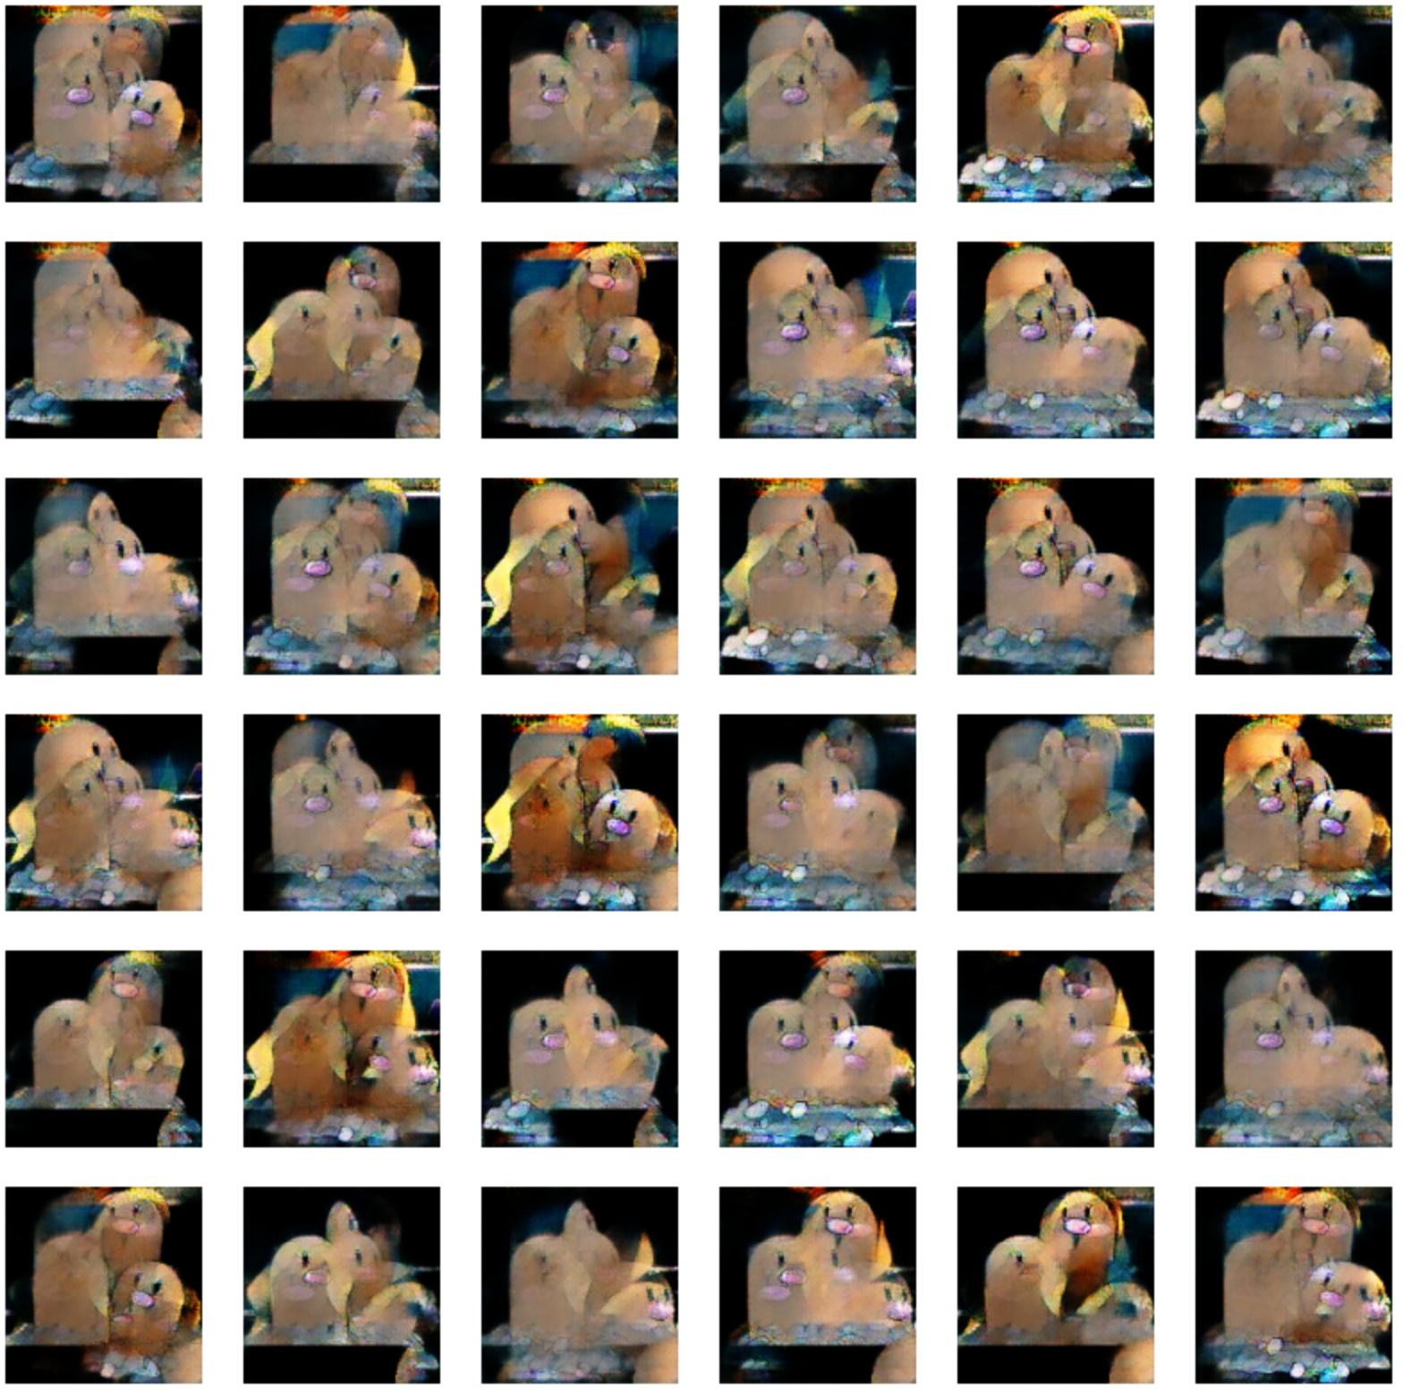
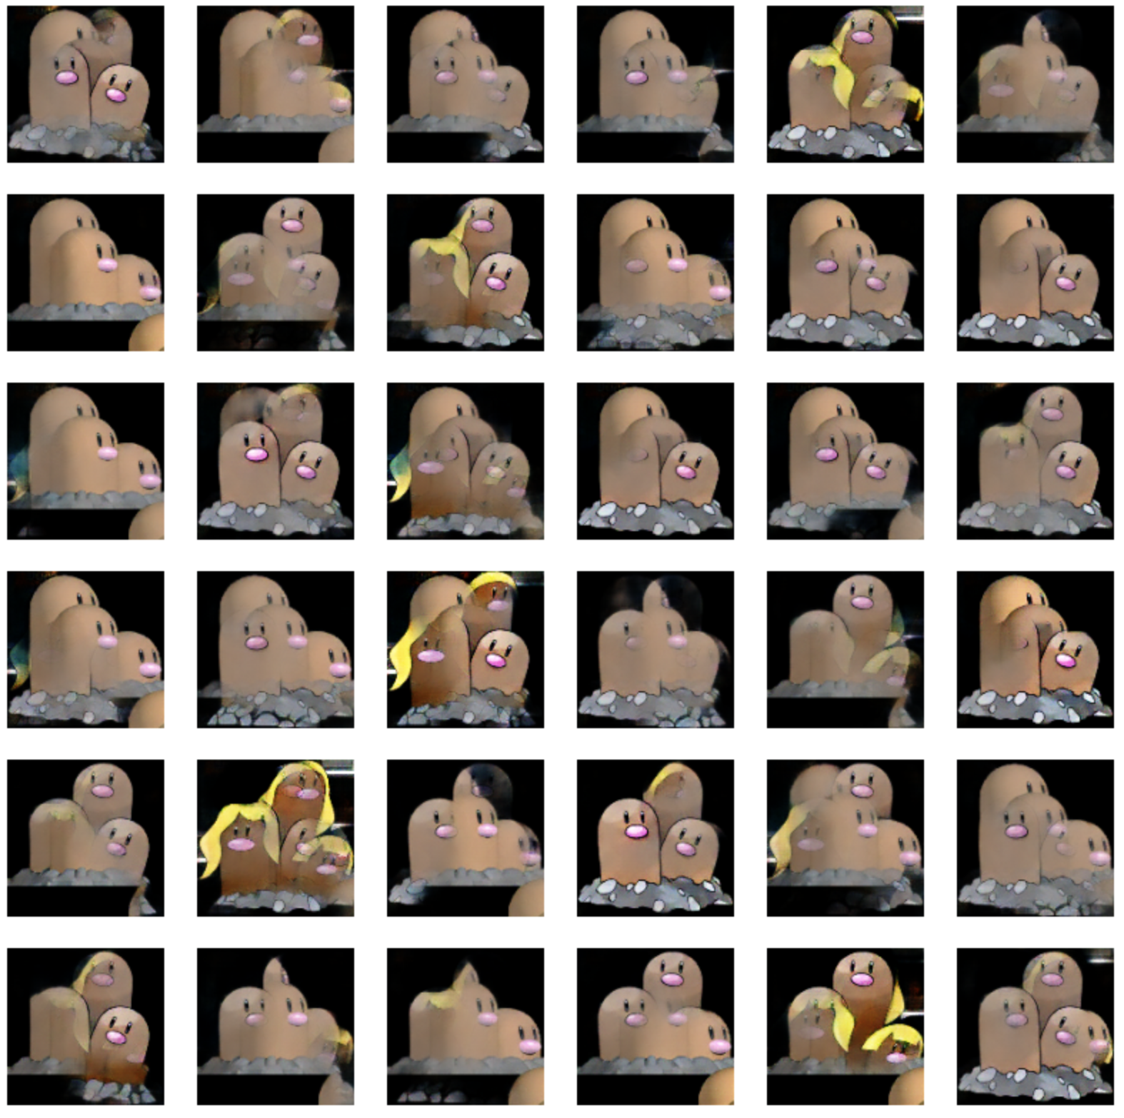
epoch 2000
epoch 4000

Slide 18
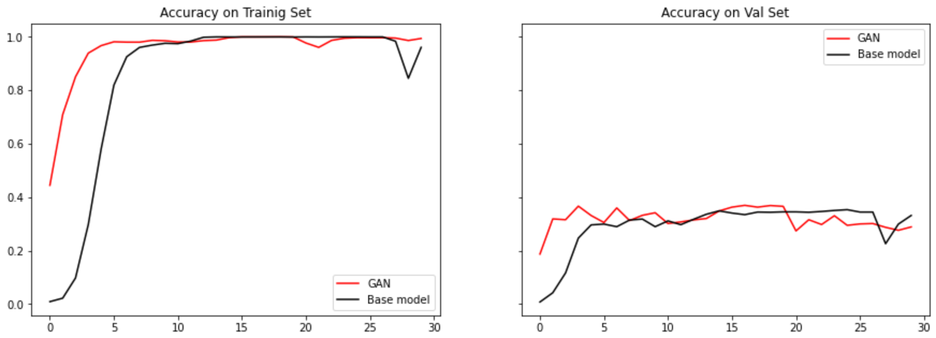
Loss and accuracy on traing and validation

Slide 19
Learning Rate
decay （update every step)
initial rate
decay_rate
decay_step
reduction (update only if the monitor doesn’t improve after a number of steps)
factor
patience
min_lr

Slide 20
Deeper Architecture
Resnet
MobileNet

Slide 21
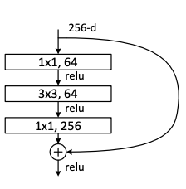
Deeper Architecture: Resnet
ResNet-50 model is a convolutional neural network (CNN) that is 50 layers deep. (https://arxiv.org/abs/1512.03385)
Residual Network solves the problem of vanishing gradient or exploding gradient as the network level becomes deeper and deeper
Deeper Bottleneck Architectures：
The three layers are 1X1, 3X3, and 1X1 convolutions, where the 1X1 layers are responsible for reducing and then increasing(restoring) dimensions, leaving the 3X3 layer a bottleneck with smaller input/output dimensions.

Slide 22
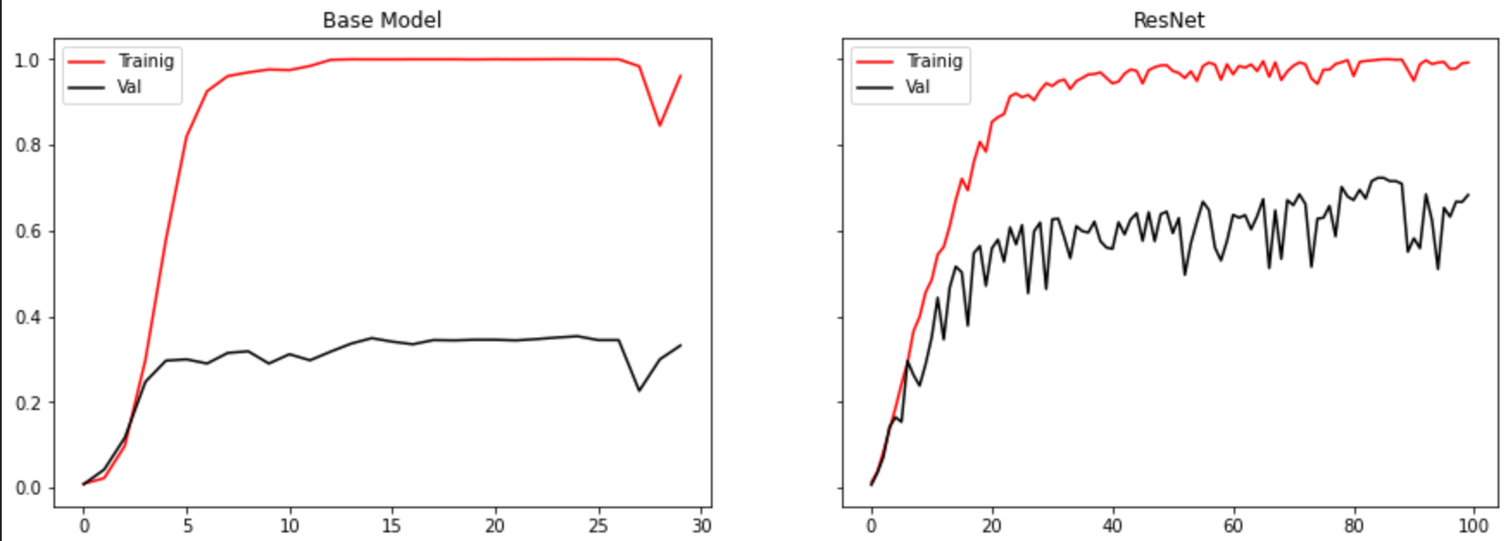
Loss and accuracy on traing and validation

Slide 23
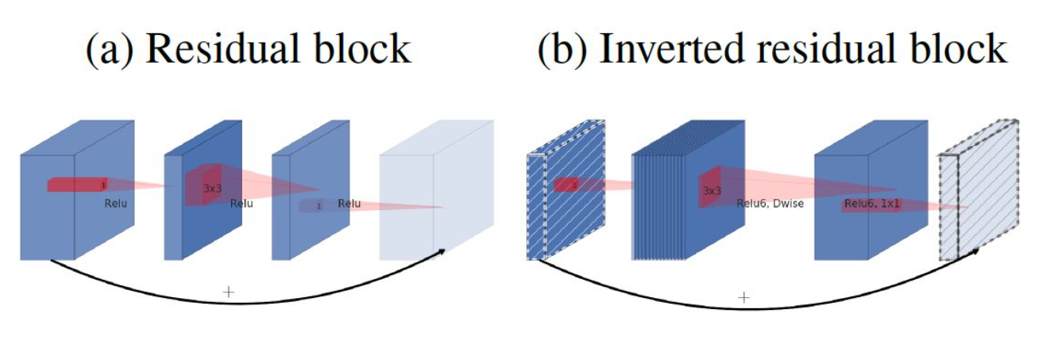
Deeper Architecture: Mobile net
MobileNetV2 (https://arxiv.org/abs/1704.04861)
The MobileNetV2 architecture is based on an inverted residual structure where the input and output of the residual block are thin bottleneck layers
The linear transformation layer is used to replace the ReLU in the layer with a small number of channels.

Slide 24
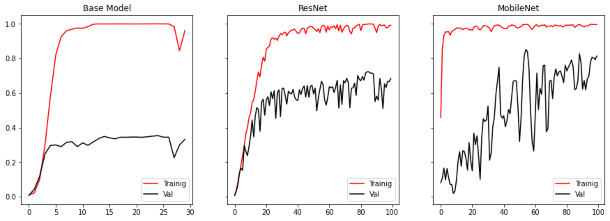
Loss and accuracy on traing and validation

Slide 25
Challenge
Computing Power
It takes 2 hours for GAN to generate 36 new images for 1 class.
Memorizing not generating
model collapse

Slide 26
Future work
imporve our DCGAN model, try to make it produce new and realiable images
manipulate all the stuff (data augmentation, GAN, dropout, etc) on fianl model

Slide 27
THANK YOU

